Slide 1



Slide 2

THE SHAPE OF FEELINGS
Monserrat Galvan
Daniel Sol
Carlos Magallanes
Jorge Sanchez
Mayra de Luna
Nilesh Modak

Slide 3


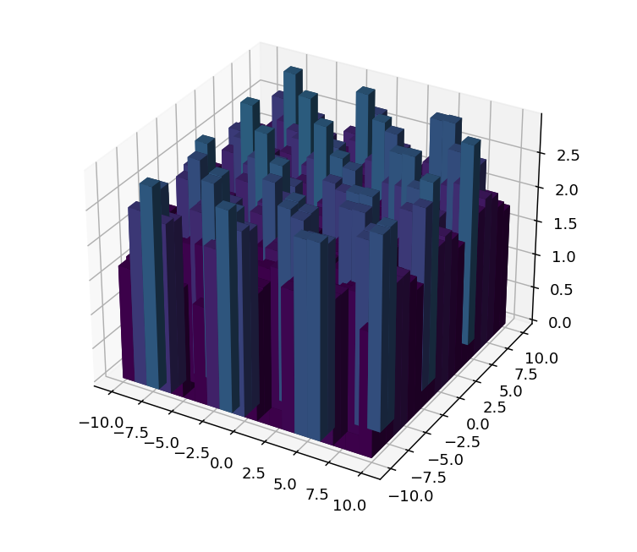
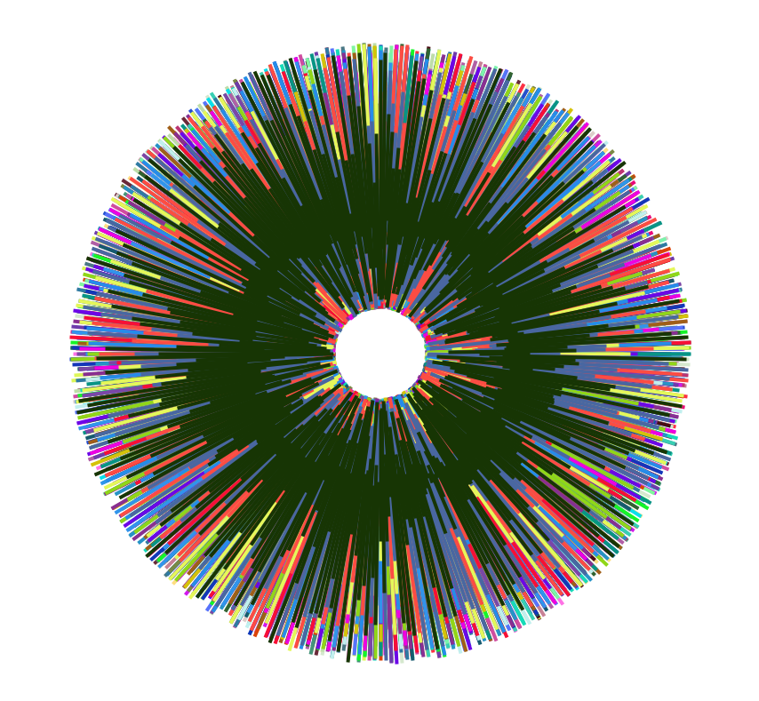

INITIAL SITUATION INTRODUCTION…

Slide 4
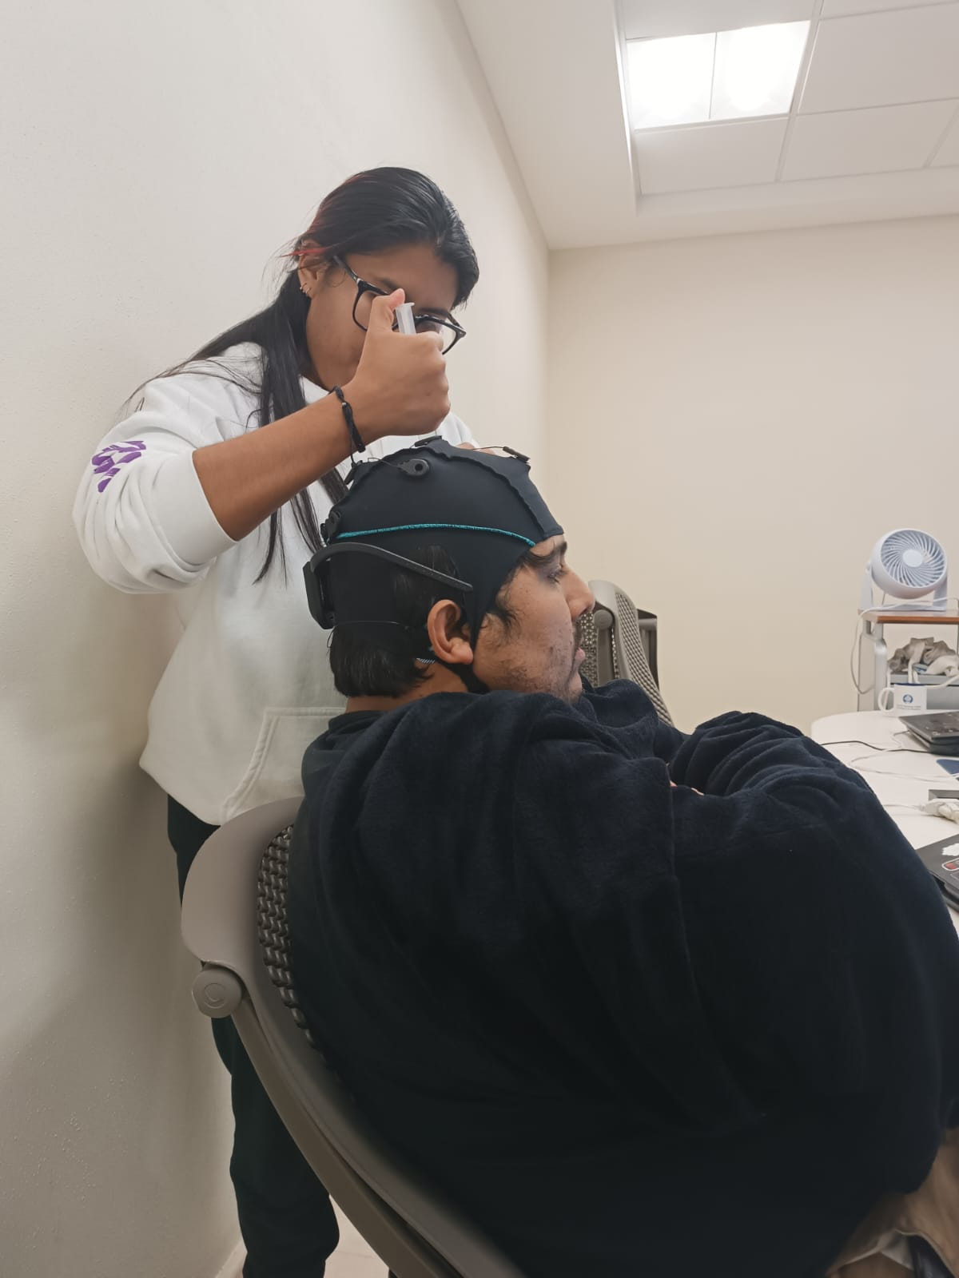
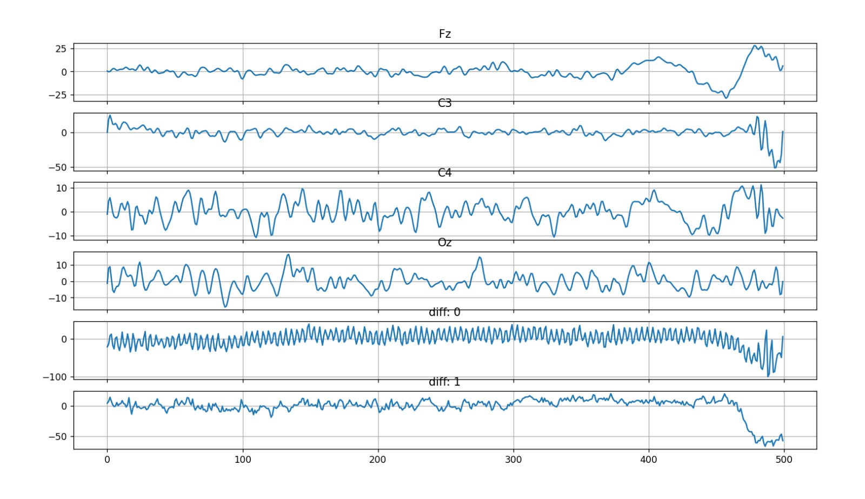
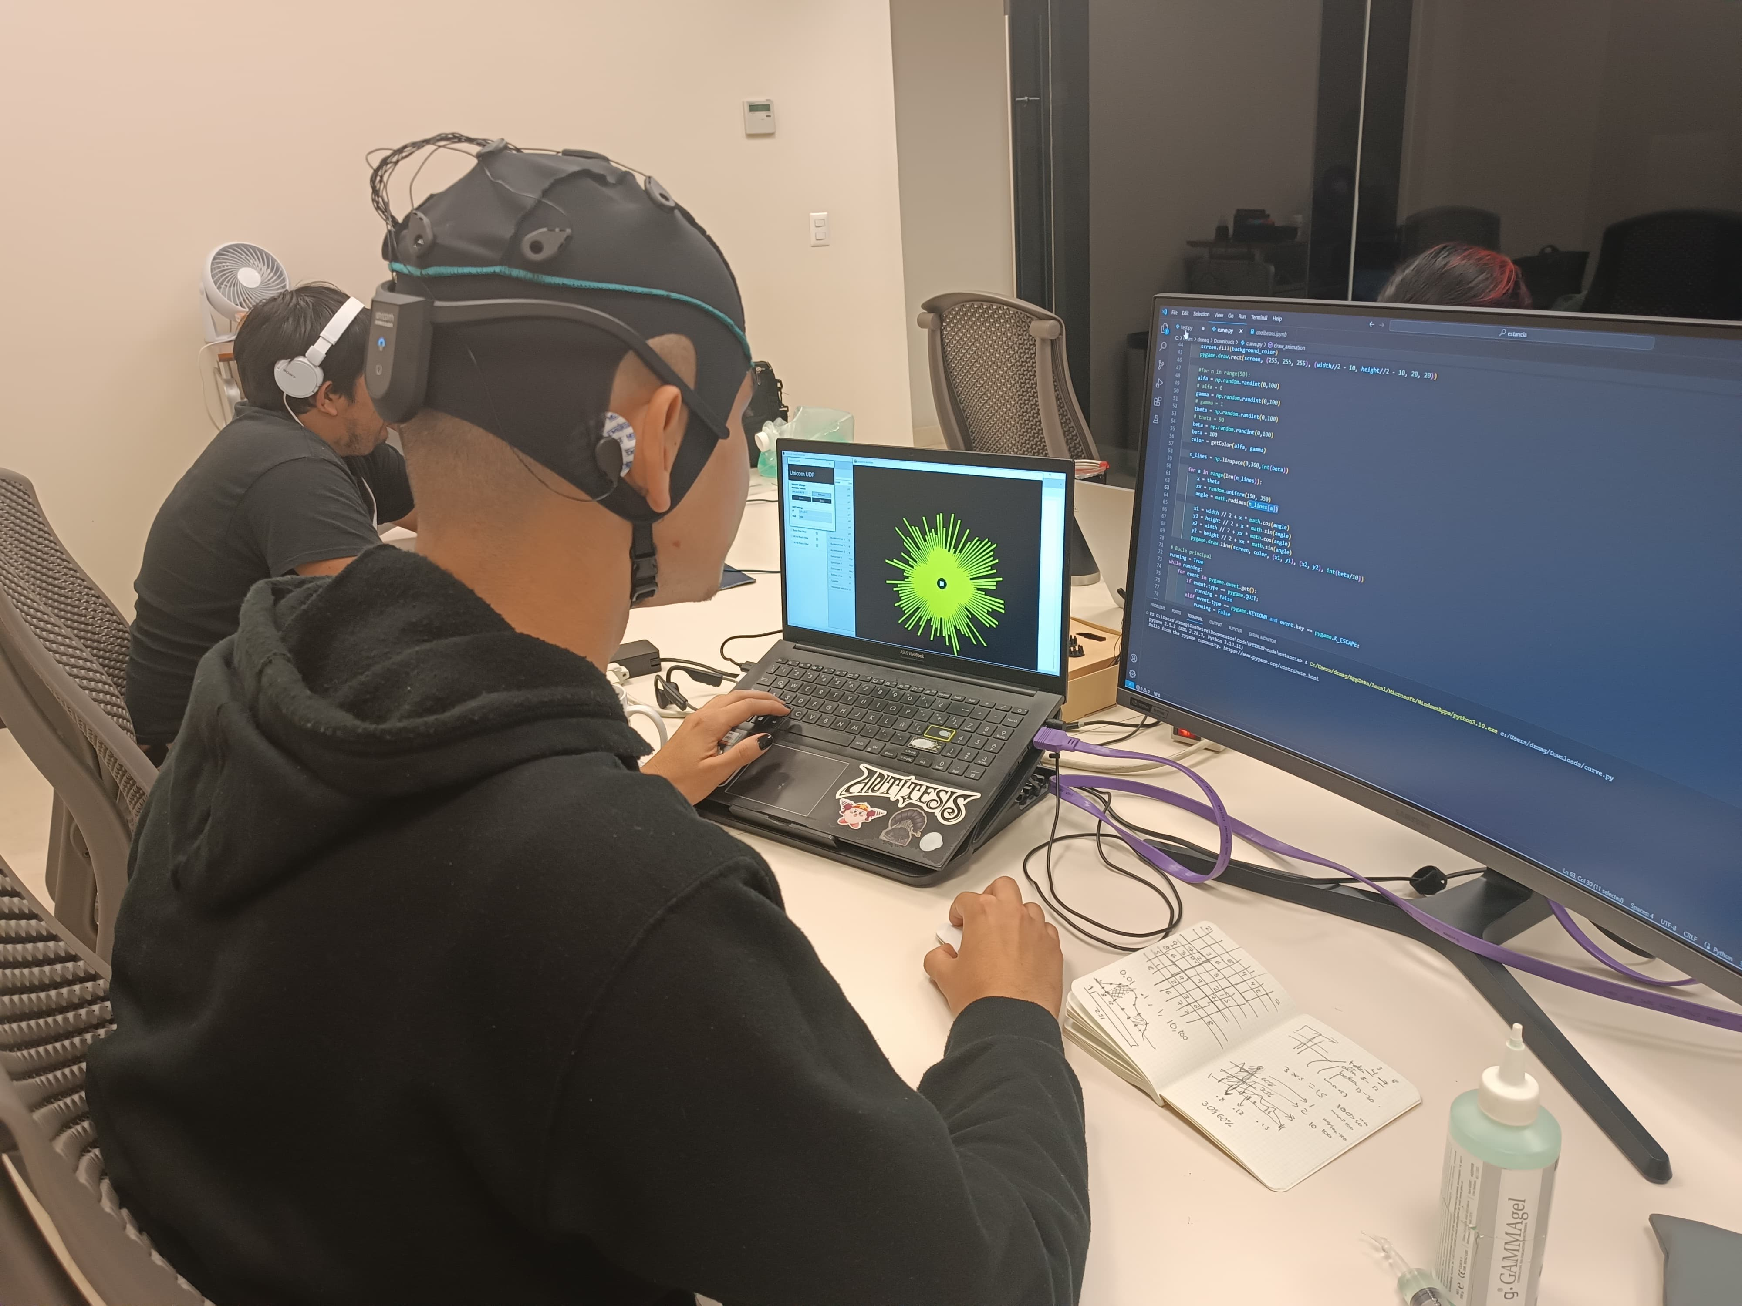
IDEA/SOLUTION…

Slide 5
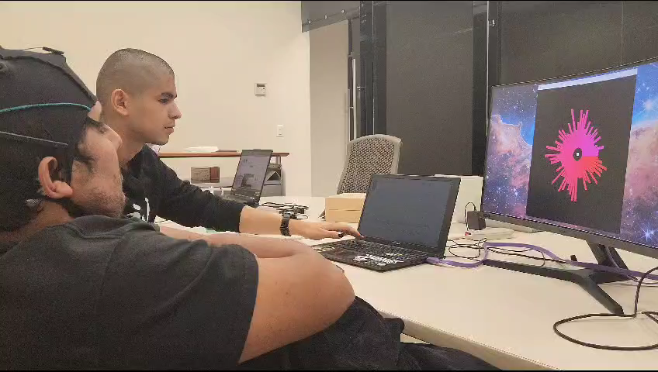
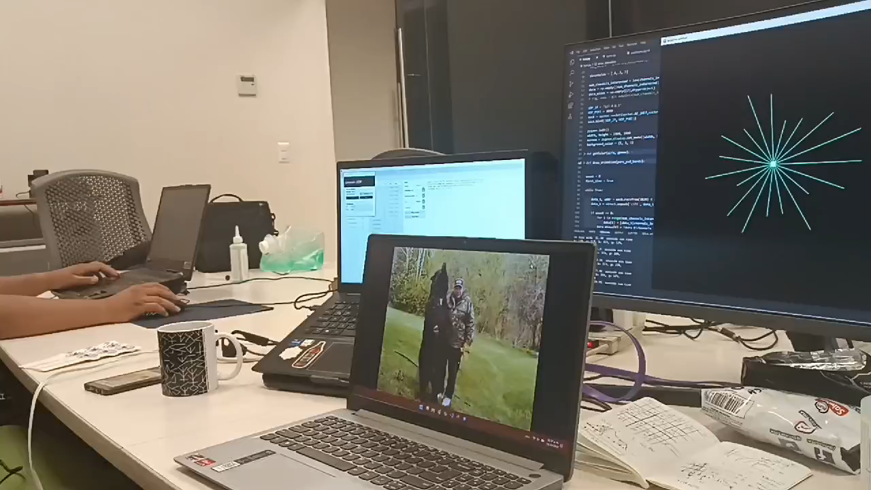
IMPLEMENTATION REALIZATION…

Slide 6
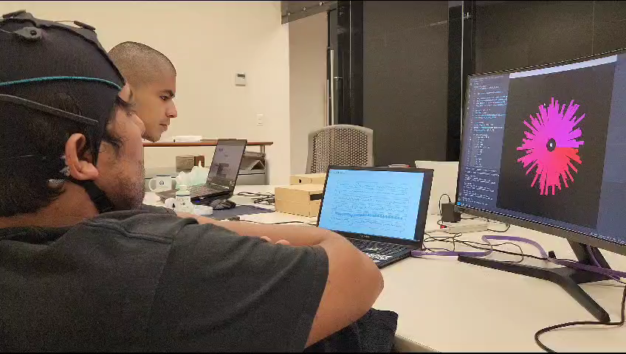
RESULTS OUTCOME…

Slide 7
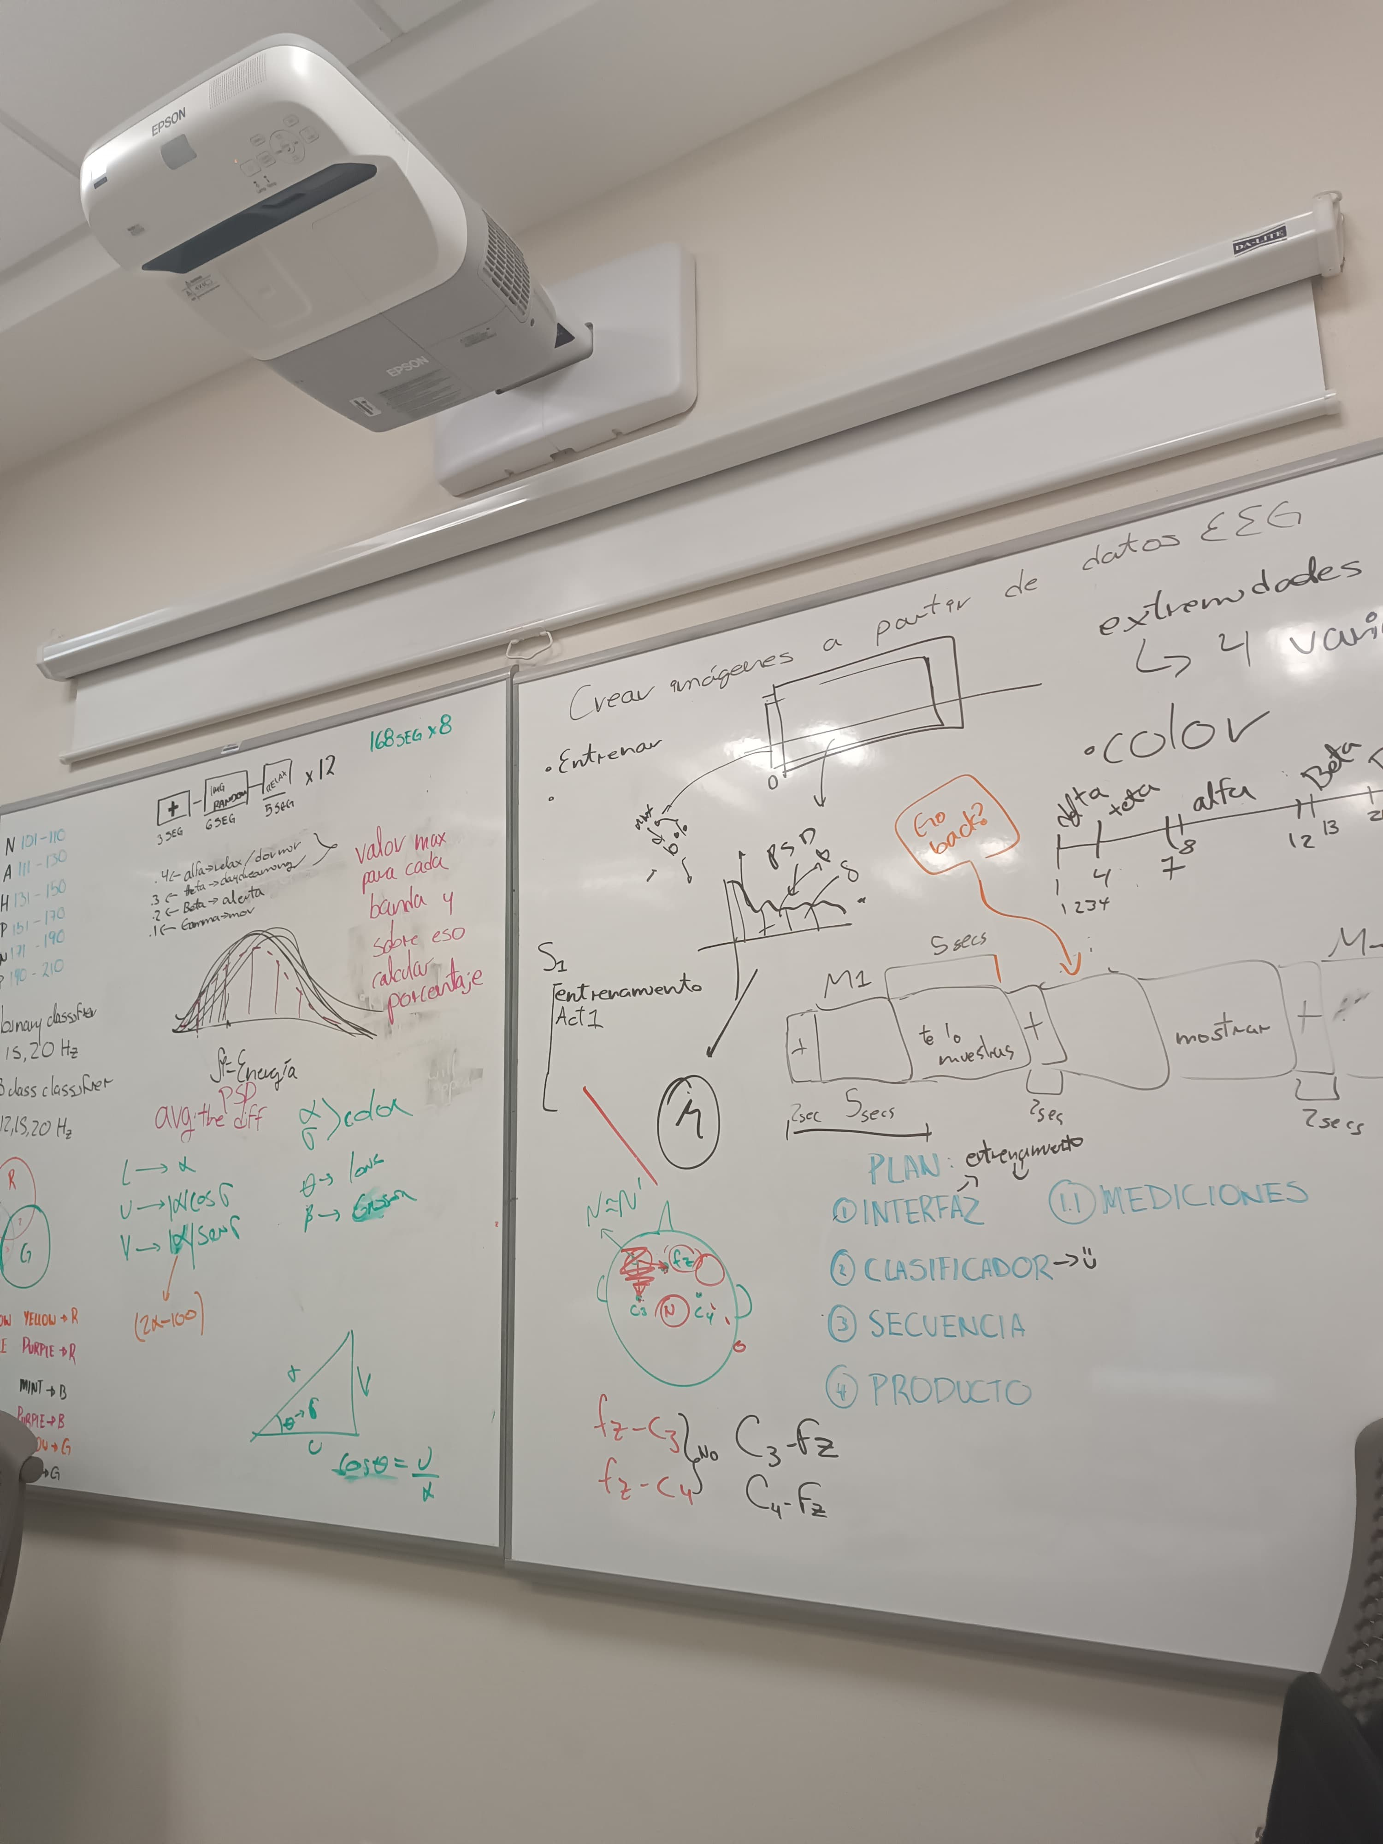
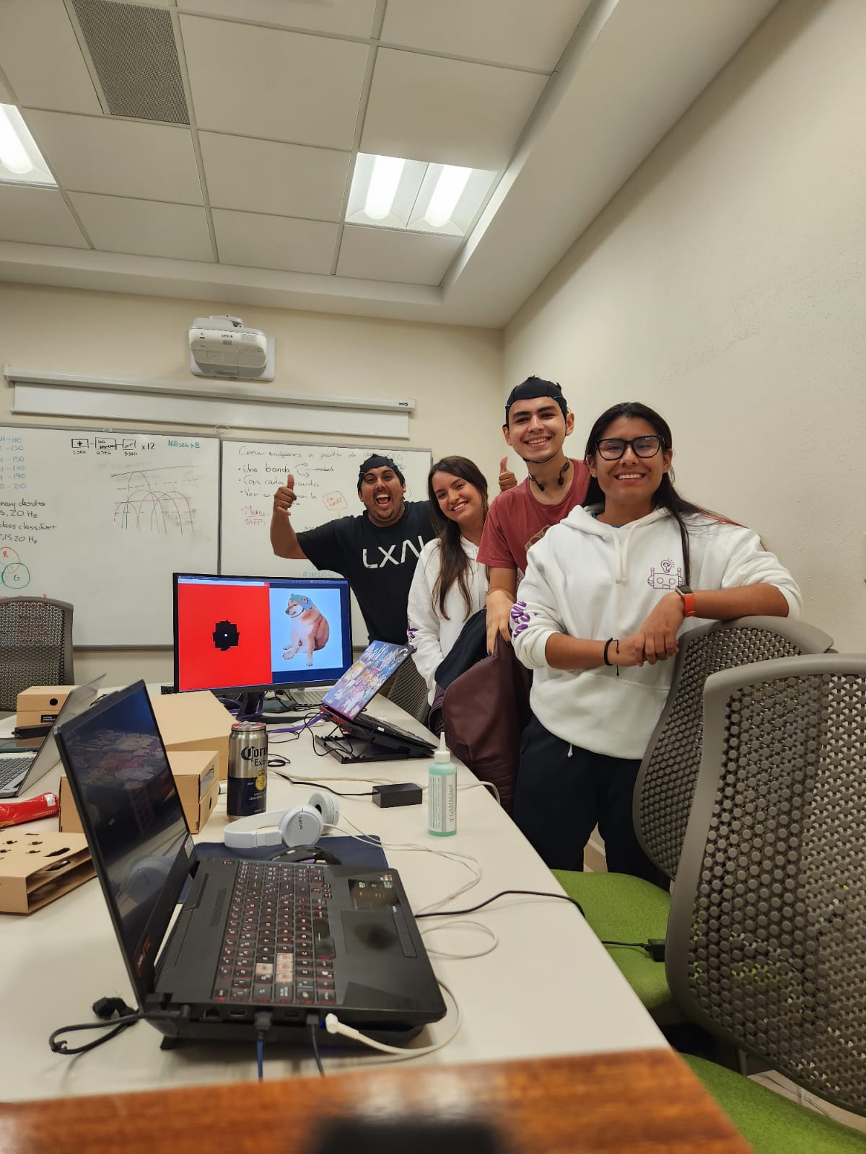
GROUP PICTURE PICS OF YOU WORKING…

